Slide 1
Marketing Essentials

Slide 2
Online Marketing
Getting Found Online

Slide 3
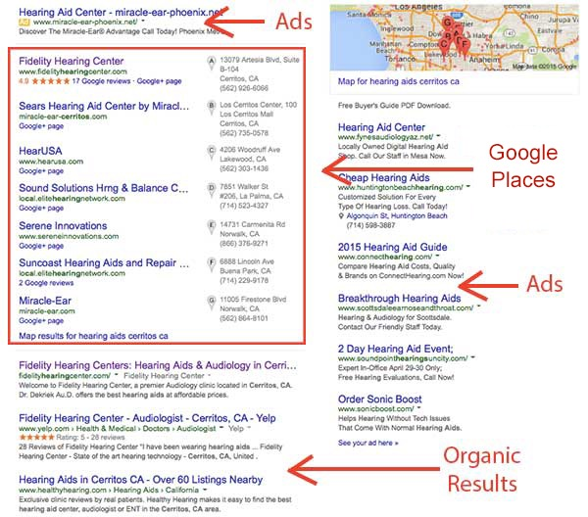
ONLINE MARKETING
Google Search Results
Google Ad Words
Google Maps/Places/Business
Online Listing Sites
Organic Results (SEO)

Slide 4
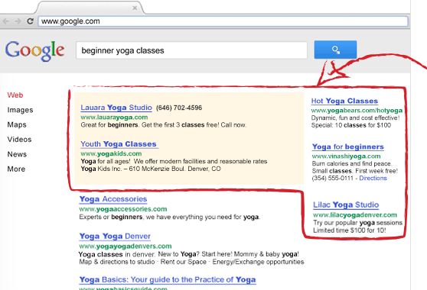
ONLINE MARKETING
Google AdWords
Google Will Create Campaign for You
Pay-Per-Click
No Visit, No Fee
Start with Any Budget

Slide 5
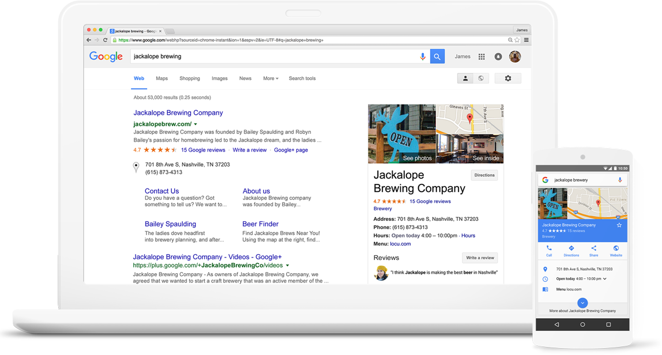
ONLINE MARKETING
Google My Business
Select Categories
Add Description & Services
Add Website/Contact Info
Add Photos
Check Map Location

Slide 6
ONLINE MARKETING
Reviews
Manage your reputation
What Are people saying about you online?
Get More Positive Reviews
Manage Negative reviews

Slide 7
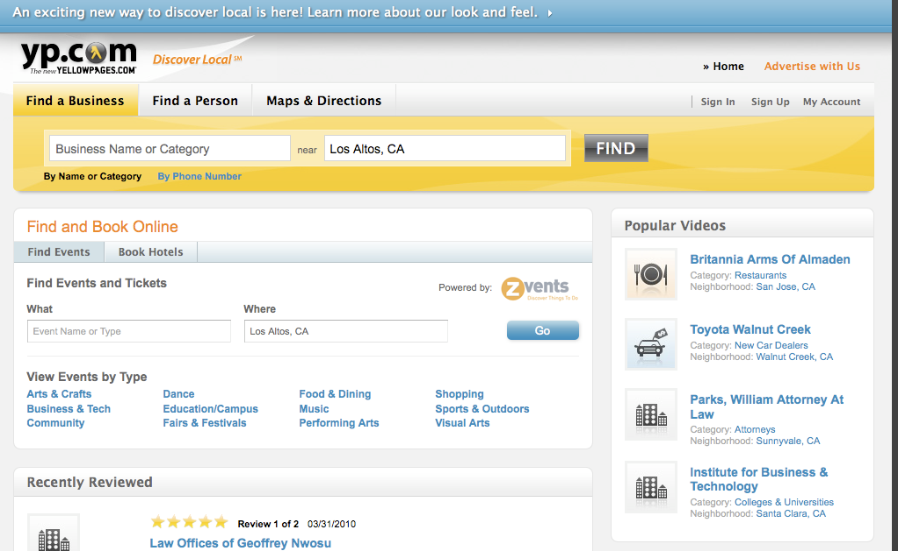
ONLINE MARKETING
Online Listings
Yelp
Yellow Pages
Dex
Manta
Angie’s List
Etc.

Slide 8
ONLINE MARKETING
ORGANIC RESULTS (SEO)
Interview Customers to Identify Keywords
Use in Important Places (site title, page titles, home page, headlines, links)
Publish Content Regularly

Slide 9
ONLINE MARKETING
Social Media
USING APPLICATIONS
Go to Your Audience
Say Something Real
Paid Promotion
Pinterest, Facebook, Instagram, LinkedIn, YouTube

Slide 10
ONLINE MARKETING
Case Study
JRJ Roofing & Construction
**Assets before Advertising
Logo + Business Cards
Professional Photography
Professional Videography
Website: Simple Landing Page
Facebook Page: Promote Posts + Request Reviews

Slide 11
ONLINE MARKETING
Pin Point Display Advertising
Targeted Digital Ads
Mobile Geo-Fencing
Category Contextual Targeting
Keyword Contextual Targeting
Site Retargeting

Slide 12
Thank you.
JENNAJONESDESIGN.com

