Slide 1
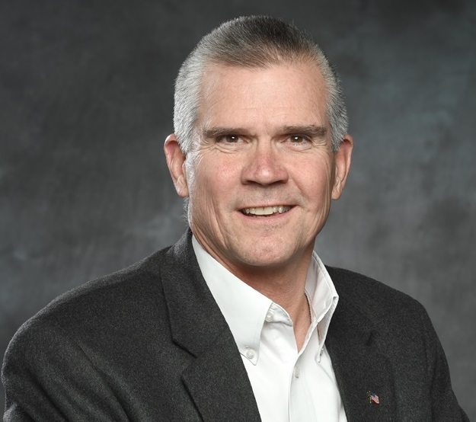
Montana State Auditor
The Office of Montana State Auditor, Commissioner of Securities and Insurance, is a criminal justice agency. Our primary mission: to protect Montana’s consumers through insurance and securities regulation.
We are committed to ensuring fairness, transparency, and access in the securities and insurance industries.

Slide 2
Securities Regulation
The Securities Act of Montana charges Commissioner Rosendale and the CSI staff with the following three tasks in regards to securities regulation:
Protect the investor, persons engaged in securities transactions, and the public interest
Promote uniformity among the states; and
Encourage, promote, and facilitate capital investment in Montana

Slide 3
What is a Security? SEC v. W. J. Howey Company
In 1946 the Supreme Court of the United States outlined a method of determining if an investment is covered by the Securities Act of 1933. It is known as the Howey test.
An investment due to
an expectation of profits arising from
a common enterprise
which depends on the efforts of a promoter or third party.

Slide 4
Types of Securities
Debt securities - raise money by obtaining loans from investors.
Equity securities – raise money by selling ownership interest in your company.

Slide 5
Basic General Rule
MCA 30-10-202. Registration of securities. It is unlawful for any person to offer or sell any security in this state, except securities exempt under 30-10-104 or when sold in transactions exempt under 30-10-105, unless:
(1) the security is registered by notification, coordination, or qualification under parts 1 through 3 of this chapter; or
(2) for a federal covered security, the security has been filed with the commissioner pursuant to 30-10-211 and the fee prescribed in 30-10-209 has been paid.

Slide 6
Securities Registration
Issuers can register their securities with the Securities and Exchange Commission and with state securities regulators. Once a security is registered, it is considered a public offering.
MCA §§ 30-10-204 and 205 set forth the requirements for securities registration.

Slide 7
Exempt Securities
MCA § 30-10-104: Provides for the exemption of certain types of securities such as:
securities issued by governments (federal, state, county, city)
securities issued non-profit issuers such as churches, hospitals, schools, fraternal organizations
employee stock purchase plans
securities listed on the New York Stock Exchange, the American Stock Exchange, the NASDAQ
securities issued by insurance companies

Slide 8
Exempt Transactions
MCA § 30-10-105: Exempt transactions provides exemptions for both the security and the offer and sale of the security. Following are some examples:
MCA § 30-10-105(8)(a ): Exempt offering to not more than 10 investors
MCA § 30-10-105(8)(b ): Exempt offering to not more than 25 investors
MCA § 30-10-105(8)(c ): Exempt offering to not more than 35 investors (Montana businesses only)
MCA § 30-10-105(22): Exempt securities crowdfunding exemption
MCA § 30-10-105(21): Exempt securities cooperative exemption

Slide 9
Requirements for all
Securities Offerings
Don’t discount disclosure.
Whether a securities offering is registered or exempt from registration, the issuer is always required to make full disclosure to prospective investors.
Federal and state securities laws require the issuer to disclose all material facts and risks to investors.
If you do not comply with disclosure requirements, you and your business may have committed securities fraud and could be subject to private lawsuits as well as administrative or criminal enforcement actions. Full disclosure is the best way for a business to protect itself.

Slide 10
What is “Full Disclosure?”
What type of securities are being offered
What type of business does the issuer conduct
What are the risks associated with the issuer and the investment
Who are the business’ officers and directors and what are their salaries
How is the business capitalized
How much money is being raised from investors
How will the investment proceeds be spent
And more…anything material…full disclosure protects everyone and is required by Montana law
Disclosure is usually made through a prospectus or
private placement memorandum

Slide 11
What is Crowdfunding?
Crowdfunding is a money-raising strategy that began as a way for the public to donate small amounts of money, often through social networking websites, to help artists, musicians, filmmakers and other creative people finance their projects.
The concept recently has been promoted as a way of assisting small businesses and start-ups looking for investment capital to help get their business ventures off the ground.

Slide 12
Crowdfunding that is
NOT Subject to Securities Law.
Gifts: Wedding guests pay for a couples’ honeymoon.
Charities & non profits: Money is given to promote the organization with no expectation of returns.
Sales and donation based models: Startups pre-sell items they hope to produce or people donate to help a product or creative project become reality., IndiGogo, GoFundMe, Kickstarter etc.

Slide 13
Record $13 Million Raised on Kickstarter

Slide 14
Equity Crowdfunding
Federal JOBS Act of 2011 required SEC to write rules. The SEC has adopted a crowdfunding exemption, but many businesses find it cumbersome and costly.
On July 1, 2015 Montana businesses could begin conducting debt/equity crowdfunding within Montana, joining 25 other states. There are now 37 states with a crowdfunding exemption.
Investment based on-line models: AngelList, WeFunder, issuer’s own website; etc. (currently only available to accredited investors)

Slide 15
Crowdfunding in Montana
There is a 5 page application form on the CSI web site which must be completed and submitted with a $50 filing fee 10 days prior to any solicitation for money OR 15 days after the first unsolicited sale of the security.
The CSI website has a disclosure template that issuers can complete and fill out. It covers the key topics issuers need to provide information about to prospective investors.

Slide 16
Requirements of the Crowdfunding Law
§ 30-10-105(22):
The issuer (seller) can raise $1 million from Montana investors in any 12 month period.
Investors can invest up to $10,000 in the offering.
Accredited investors can invest an unlimited amount in the offering.
The issuer must be a Montana business.
The issuer must comply with all state laws, including proper registration for its company with the Montana Secretary of State www.sos.mt.gov

Slide 17
What is an Accredited Investor?
Net worth exceeds $1,000,000 (excluding the value of the primary residence) OR
Annual income exceeds $200,000 (or $300,000 jointly with a spouse) OR
An entity such as a bank, insurance company, corporation or trust with assets in excess of $5,000,000

Slide 18
Crowdfunding Requirements Continued:
Money raised from investors must be deposited into a Montana accredited bank and used only for the purpose(s) stated to investors.
People must invest for “investment purposes” which means they intend to hold the investment for at least 2 years versus speculative intentions.
No commission is paid to issuer unless the issuer uses a registered broker-dealer to sell the investment.

Slide 19
Examples of Crowdfunding in Montana
Distillery
Manufacturers (purses, guns, software, fly & bee traps)
Internet company
Real estate receivables company
Radio station
Entomophagy Venture
A movie production
Agricultural drone company
Purse manufacturer
Microbrewery

Slide 20
The Crowdfunding Exemption
Will NOT Work if…
The issuer is an investment company, investment advisor, a person convicted of a felony within the past 10 years, or barred from financial transitions by a government authority.
The business plan is vague. The issuer must have a specific, well defined purpose and plan for the company.

Slide 21
Tips for Small Businesses & Entrepreneurs
Don’t go it alone.
Businesses seeking to raise capital by registering their securities or through the use of an exemption still need legal guidance as to how to comply with the Montana law.
Issuers should consult with an attorney to help with the offering and should contact the CSI for assistance prior to conducting an offering.

Slide 22
Tips for Small Businesses & Entrepreneurs
Avoid Distractions.
Having hundreds of “owners” may distract a business’ management from devoting the time and energy that is necessary to run a successful business.
Venture capital companies or private equity funds may be less inclined to invest in a company that already has a large number of small investors.

Slide 23
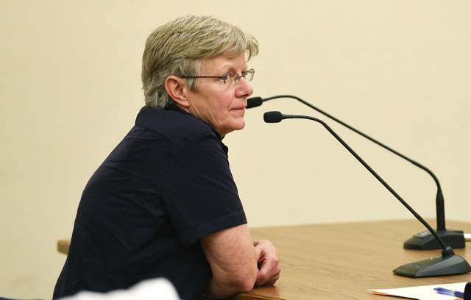
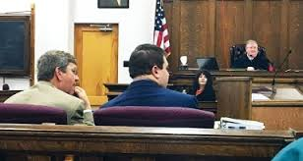
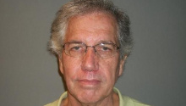
Securities Transactions Gone Bad
Catherine Finberg
Columbia Falls
13 Victims, $1.1 million
10 years prison time
Richard Brandt
Miles City
18 Victims, $1.98 million
40 years prison time
Matthew McClintock a/k/a Lucas McCone, a/k/a Michael Willis, a/k/a Odell McClintock
2 Victim, $40,000
1 year prison time

Slide 24
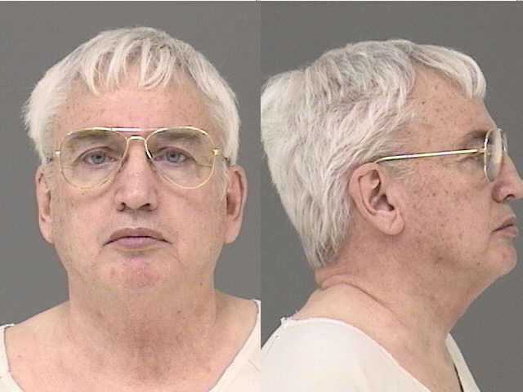
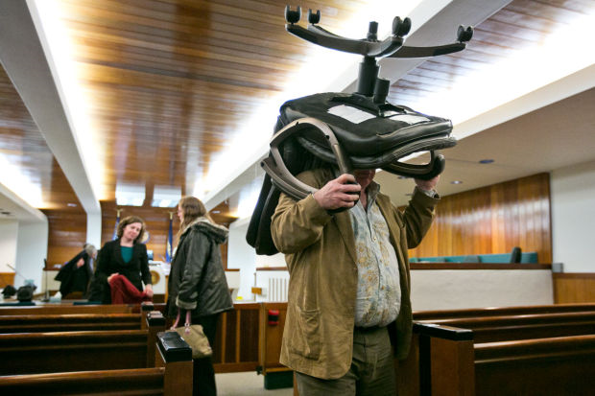
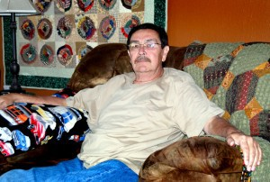
Bad Actors…continued
Kenneth Hatzenbeller
15 victims
$1.76 million scheme
30 month federal sentence; 6 year deferred state
Arthur Heffelfinger
38 Montana victims
$2.1 million scheme
10 years prison
Richard Reynolds
141 victims
$5.4 million lost
20 years prison
Robert Congdon
150 Montana victims
$14 million scheme
3 years prison

Slide 25
Most Common Securities Fraud
Pyramid Schemes Unsuitable Investments
Ponzi Schemes Promissory Notes
Churning Unauthorized Trading
Excessive Trading Excessive Fees

Slide 26
In Summary
Funding or growing a business with investor capital can eliminate the need for debt service, can include a community, and can create pride in local ownership.
The CSI has the resources and expertise to assist a business in every step of the way with its capital formation efforts.
800-332-6148
or 406-444-2040

