Slide 1
Insights From Behavioral Economics To Help You Sell (Persuade) Better

Slide 2
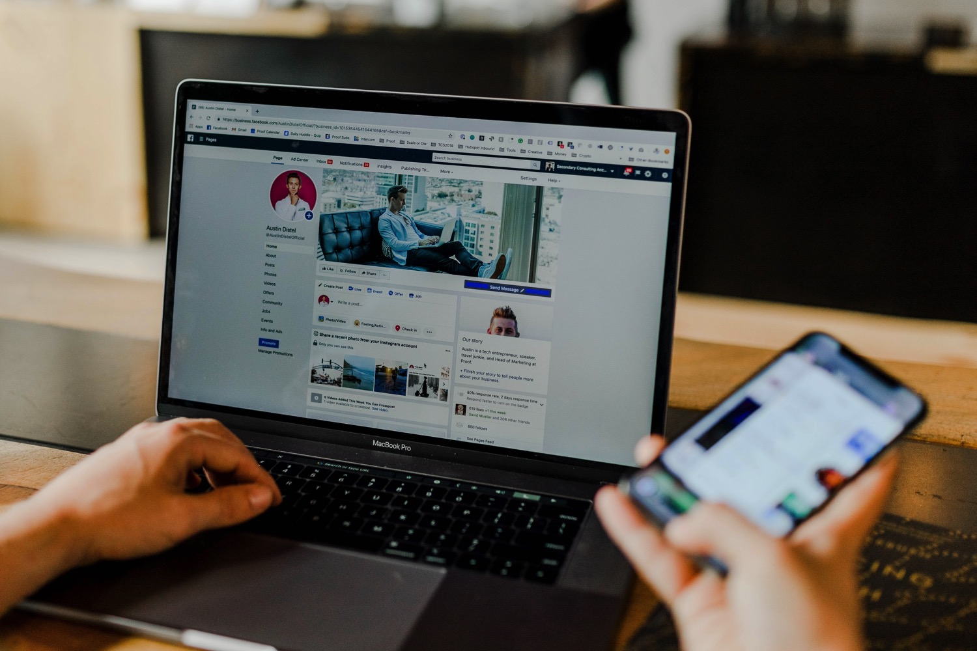
Environment Shapes Behavior

Slide 3
Emotions Emotions prioritize (or assign values) to our choices.
With Emotions Without Emotions

Slide 4
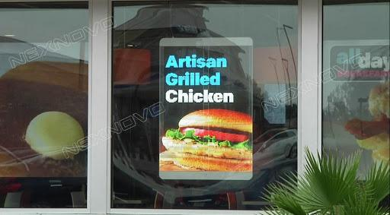
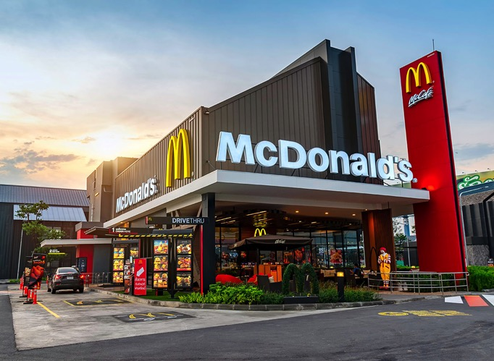
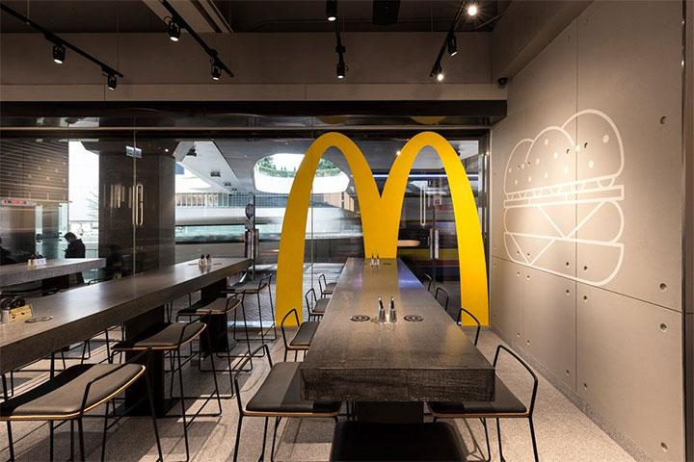
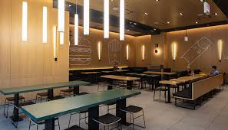

Slide 5
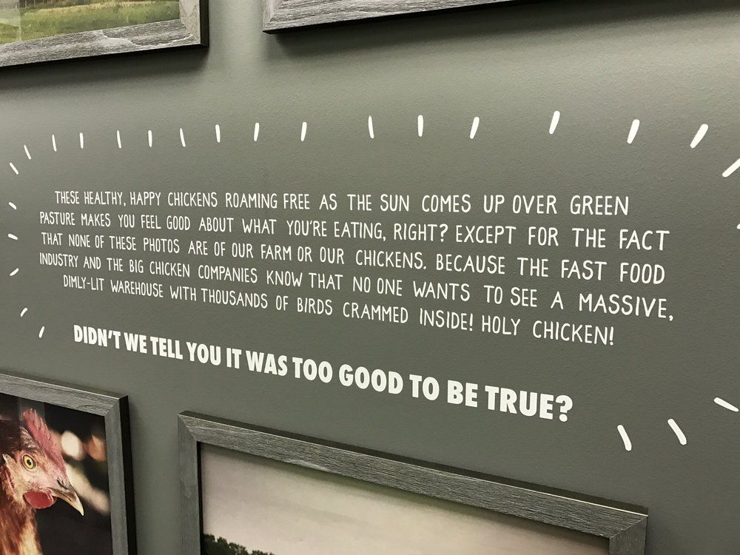
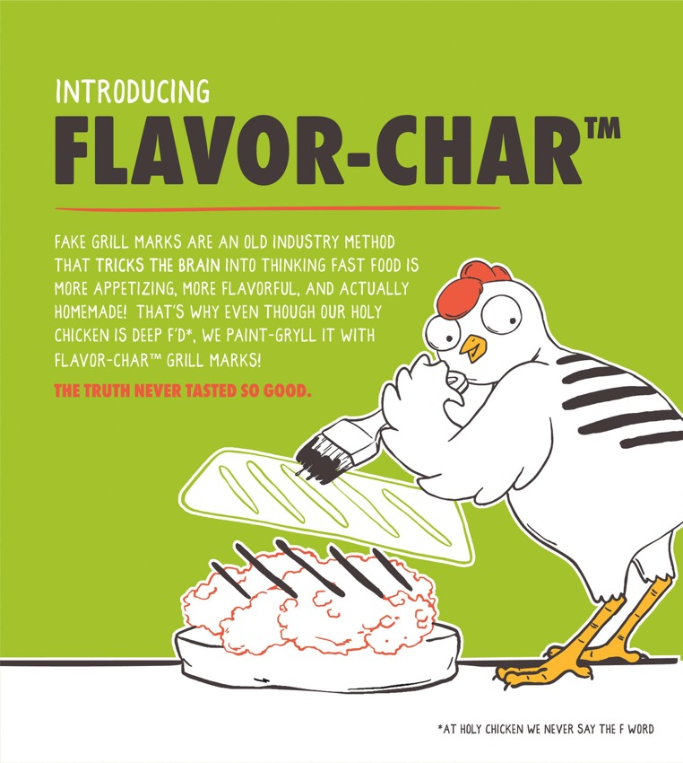
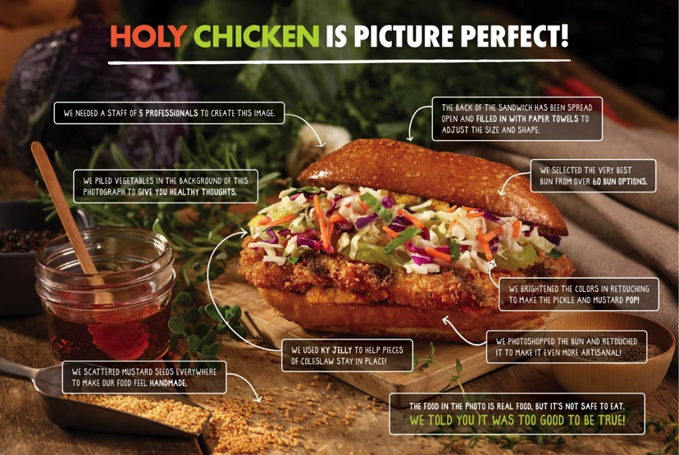
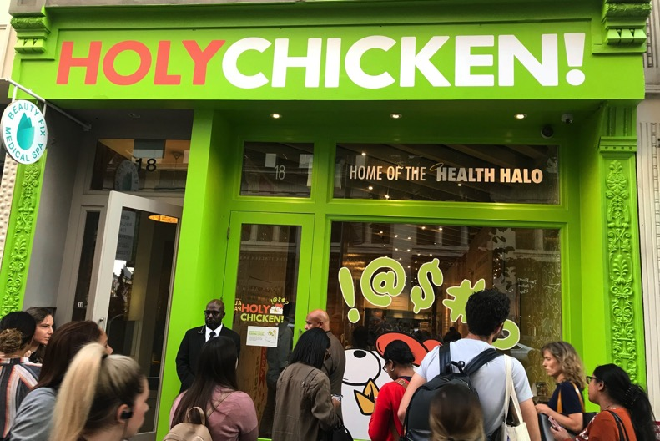

Slide 6
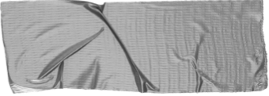
3 B’s of Behavior Change
Identify Key Behaviors THE KEY BEHAVIOR IS A SPECIFIC AND MEASURABLE ACTION YOU WANT A CUSTOMER TO TAKE.
Reduce Barriers BARRIERS ARE THE FRICTION THAT PREVENT CUSTOMER FROM DOING OUR KEY BEHAVIOR.
Amplify Benefits BENEFITS ENCOURAGE AND MOTIVATE CUSTOMER TO DO OUR KEY BEHAVIOR.

Slide 7
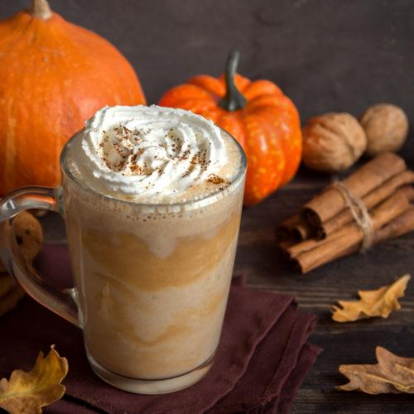
Behavior: Purchase My New Pumpkin Spice Latte
“A new customer asks the cashier for a grande pumpkin spice latte.”

Slide 8
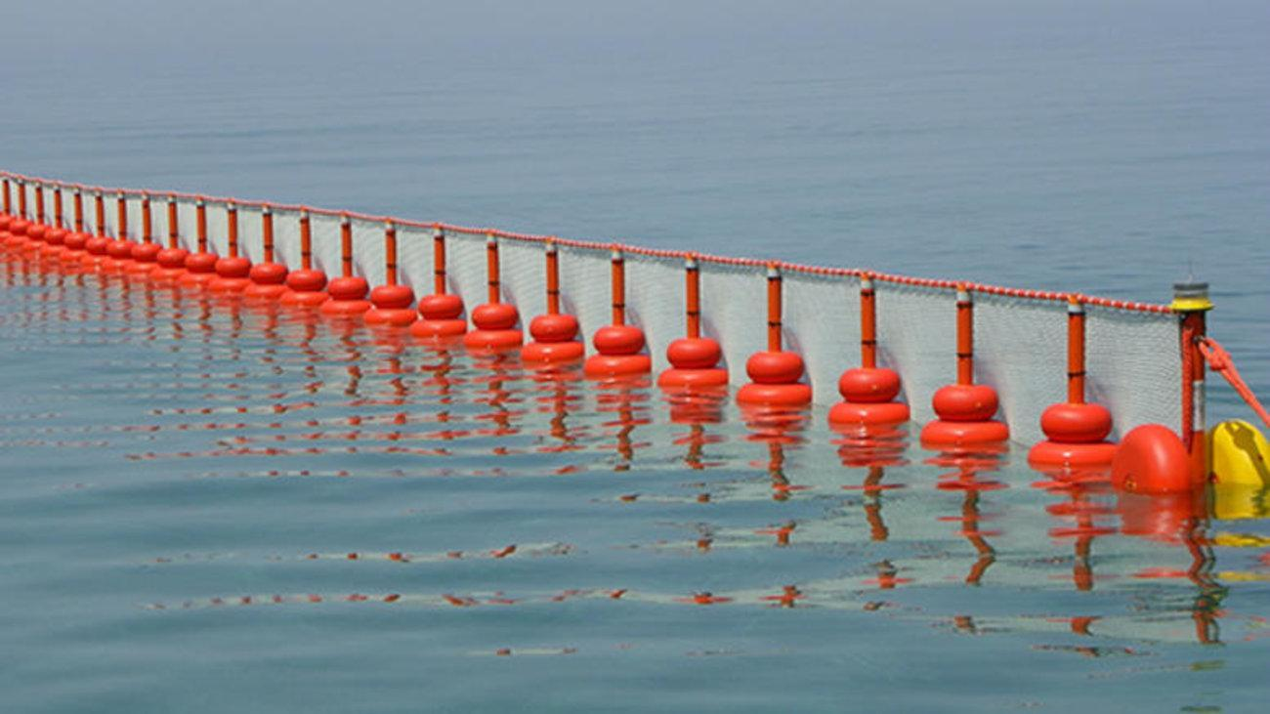
Barriers- People are not currently purchasing my new pumpkin spice latte because:
TIME-It takes too much time to purchase
ENERGY-It’s too much of hassle to find a place to park
FEAR-They’re scared they won’t like it
FEAR-It costs too much
FEAR-It looks like it will cost too much
FEAR-Too much sugar. Scared it will make them fat
Cognitive Overload-Don’t know it exists
Cognitive Overload-They forget about it when they order
Status Quo-Grab coffee at work
Status Quo-They put it off
Social Proof-They don’t see anyone buying it

Slide 9
Amplify Benefits- People will be motivated to buy because:
They don’t know it exists
Large ad posters (with a photo) inside and outside
They forget about it when they order
Poster next to menu, flyers on tables
It takes too much time to purchase
Drive thru and/or delivery
It’s too much of hassle to find a place to park
Drive thru and/or delivery
They’re scared they won’t like it
Free samples, post reviews
It costs too much
Punch card, improve branding, reduce price, BOGO

Slide 10
Amplify Benefits- People will be motivated to buy because:
It looks like it will cost too much
Advertise a discount
They normally grab coffee at work
Deliver, donate a percentage of the proceeds
They don’t like lattes with lots of sugar
Sugar free or reduced sugar options
They put it off
BOGO deal today only
They don’t see anyone with pumpkin lattes
Give away small samples to people walking by, post reviews

Slide 11
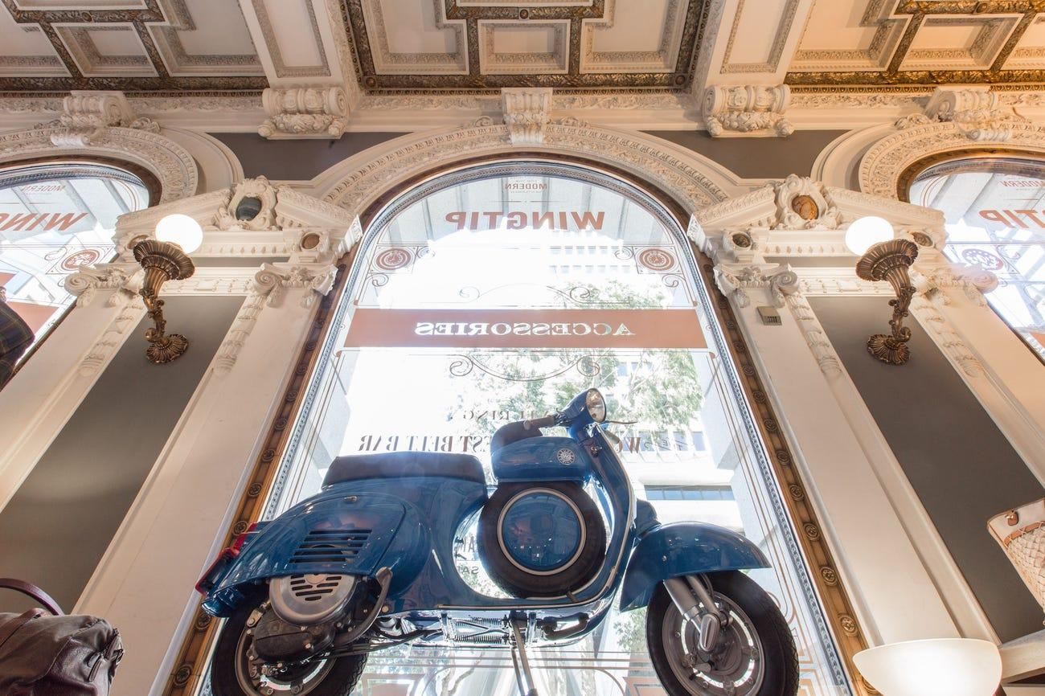
Better than expected- Experiences are like neuro price tags that can change over time.

Slide 12
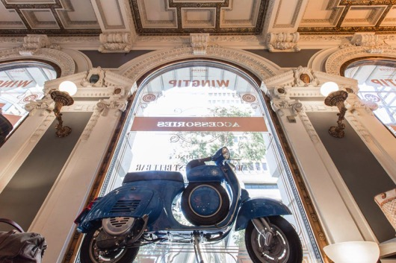
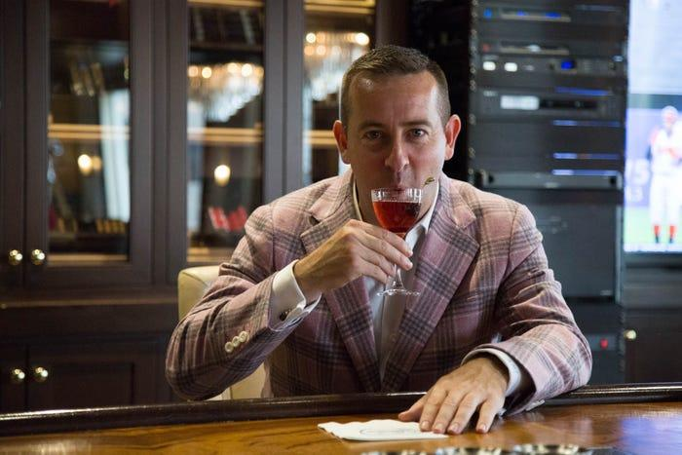
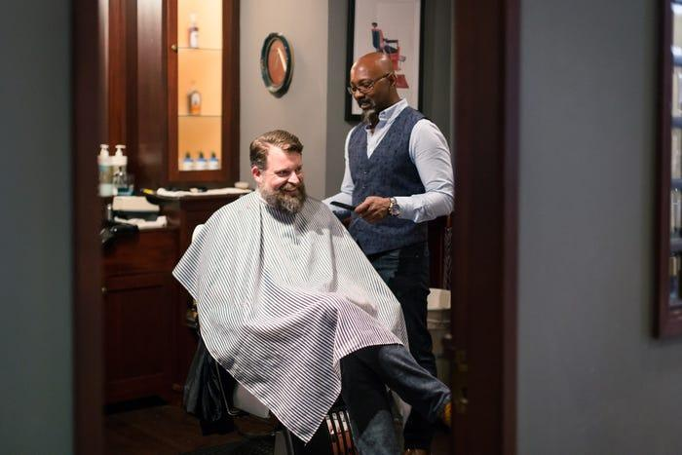
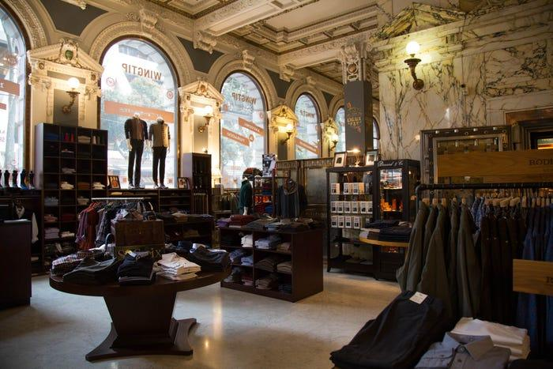
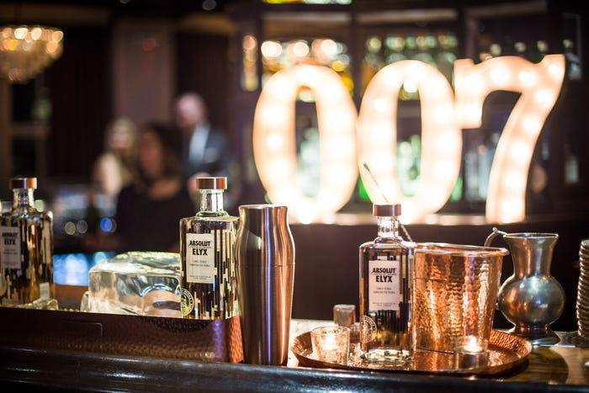

Slide 13
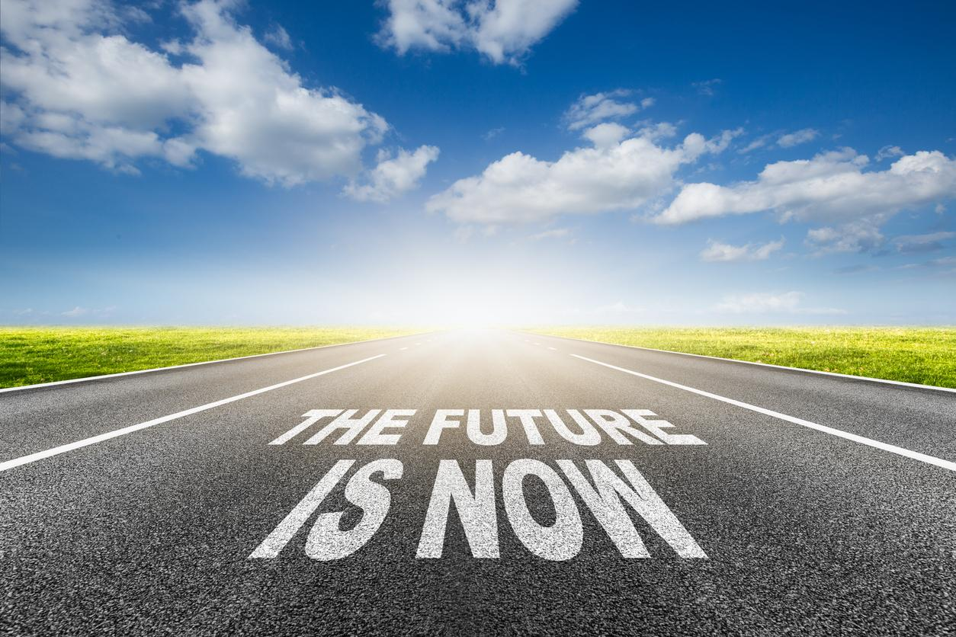
The Future is Just An Idea
The present moment is a rich multi sensory experience that’s hitting me right now. The future has much less emotional pull than what’s right in front of me.

